Slide 1
ASTRO PULSE

Slide 2
Team Members
Abhi Krishnan
Advaith S
Ajay Anil Sree
Aleena Cherian
Alisha Chandni
Ananthu S

Slide 3
Abstract
This study presents an in-depth exploration of a website dedicated to providing daily astrological forecasts to a global audience. With a focus on delivering insights into love, career, and personal growth tailored to individual zodiac signs, the platform merges ancient astrological wisdom with modern technological advancements. The website's multifaceted approach encompasses meticulous design considerations, strategic content curation, and innovative user engagement strategies.

Slide 4
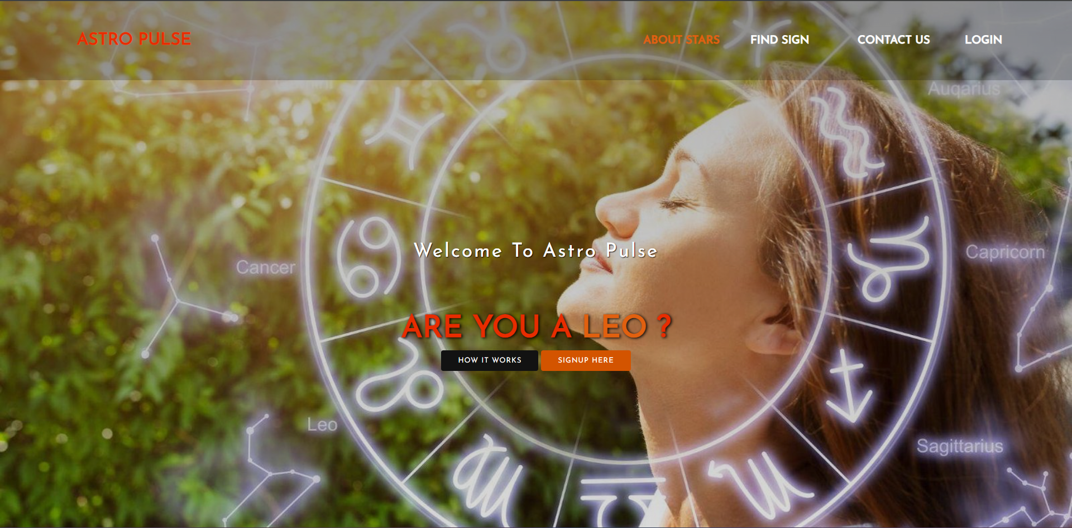

Slide 5
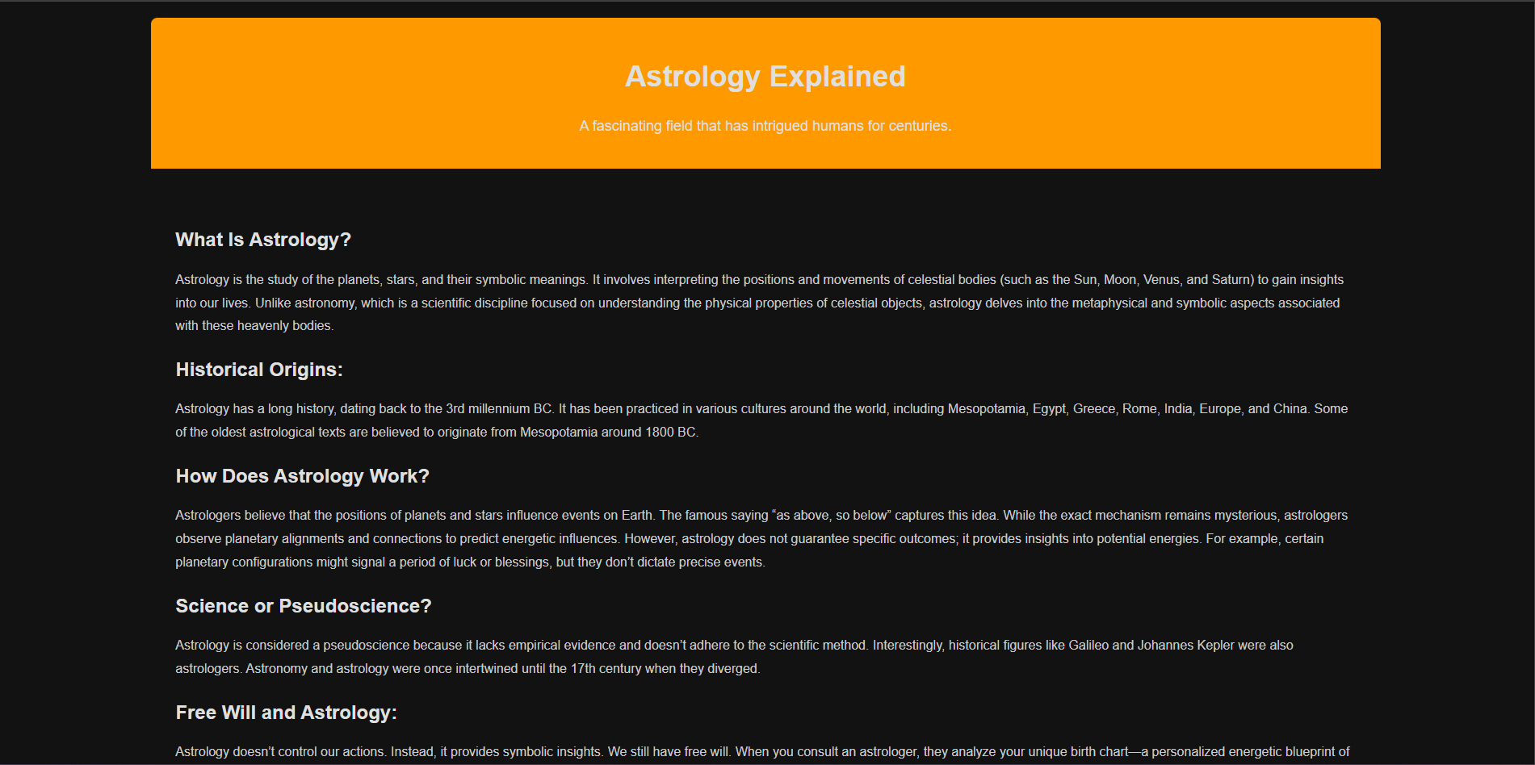

Slide 6
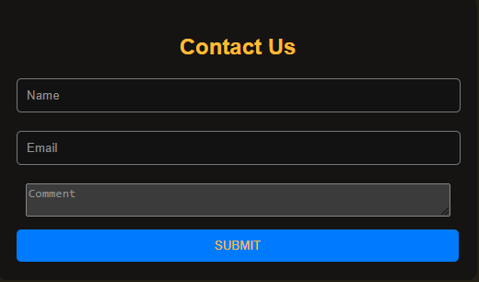

Slide 7
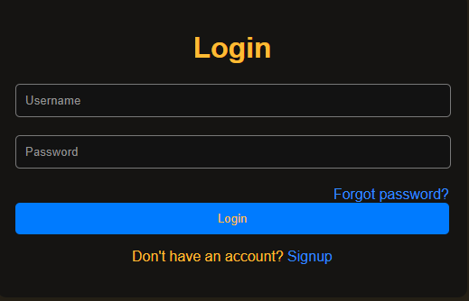

Slide 8
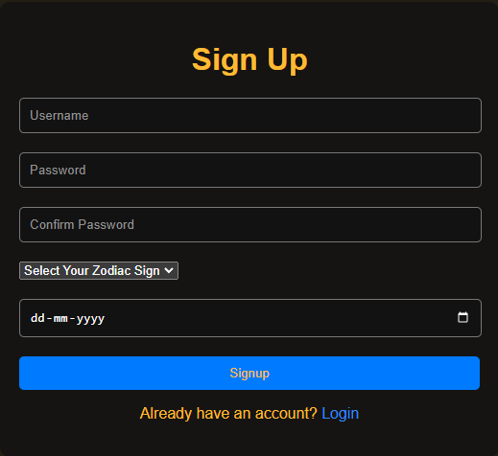

Slide 9
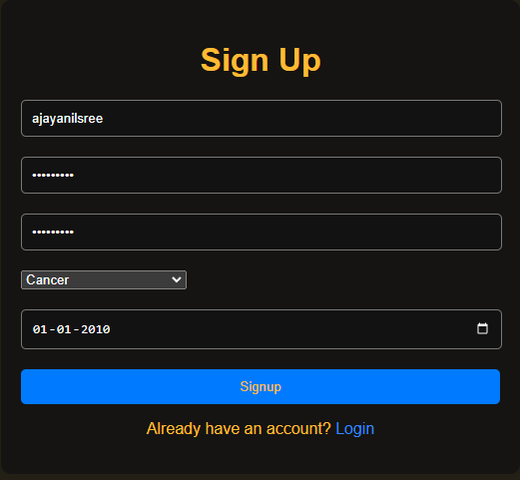

Slide 10
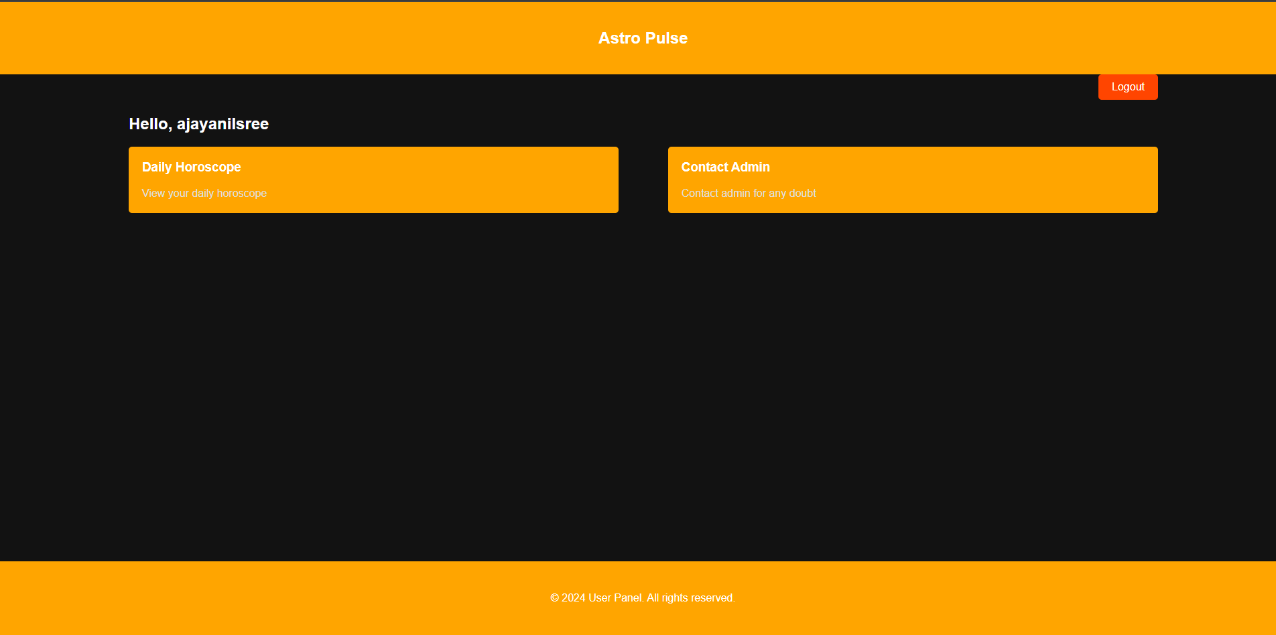

Slide 11
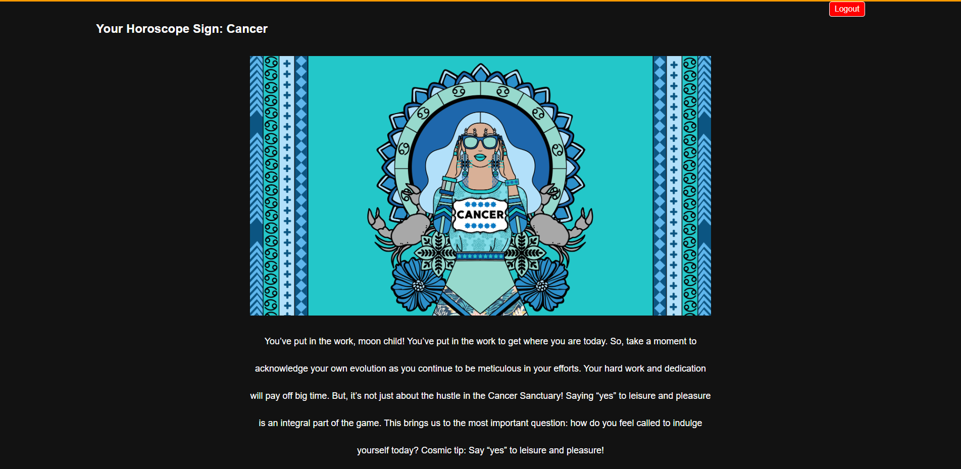

Slide 12
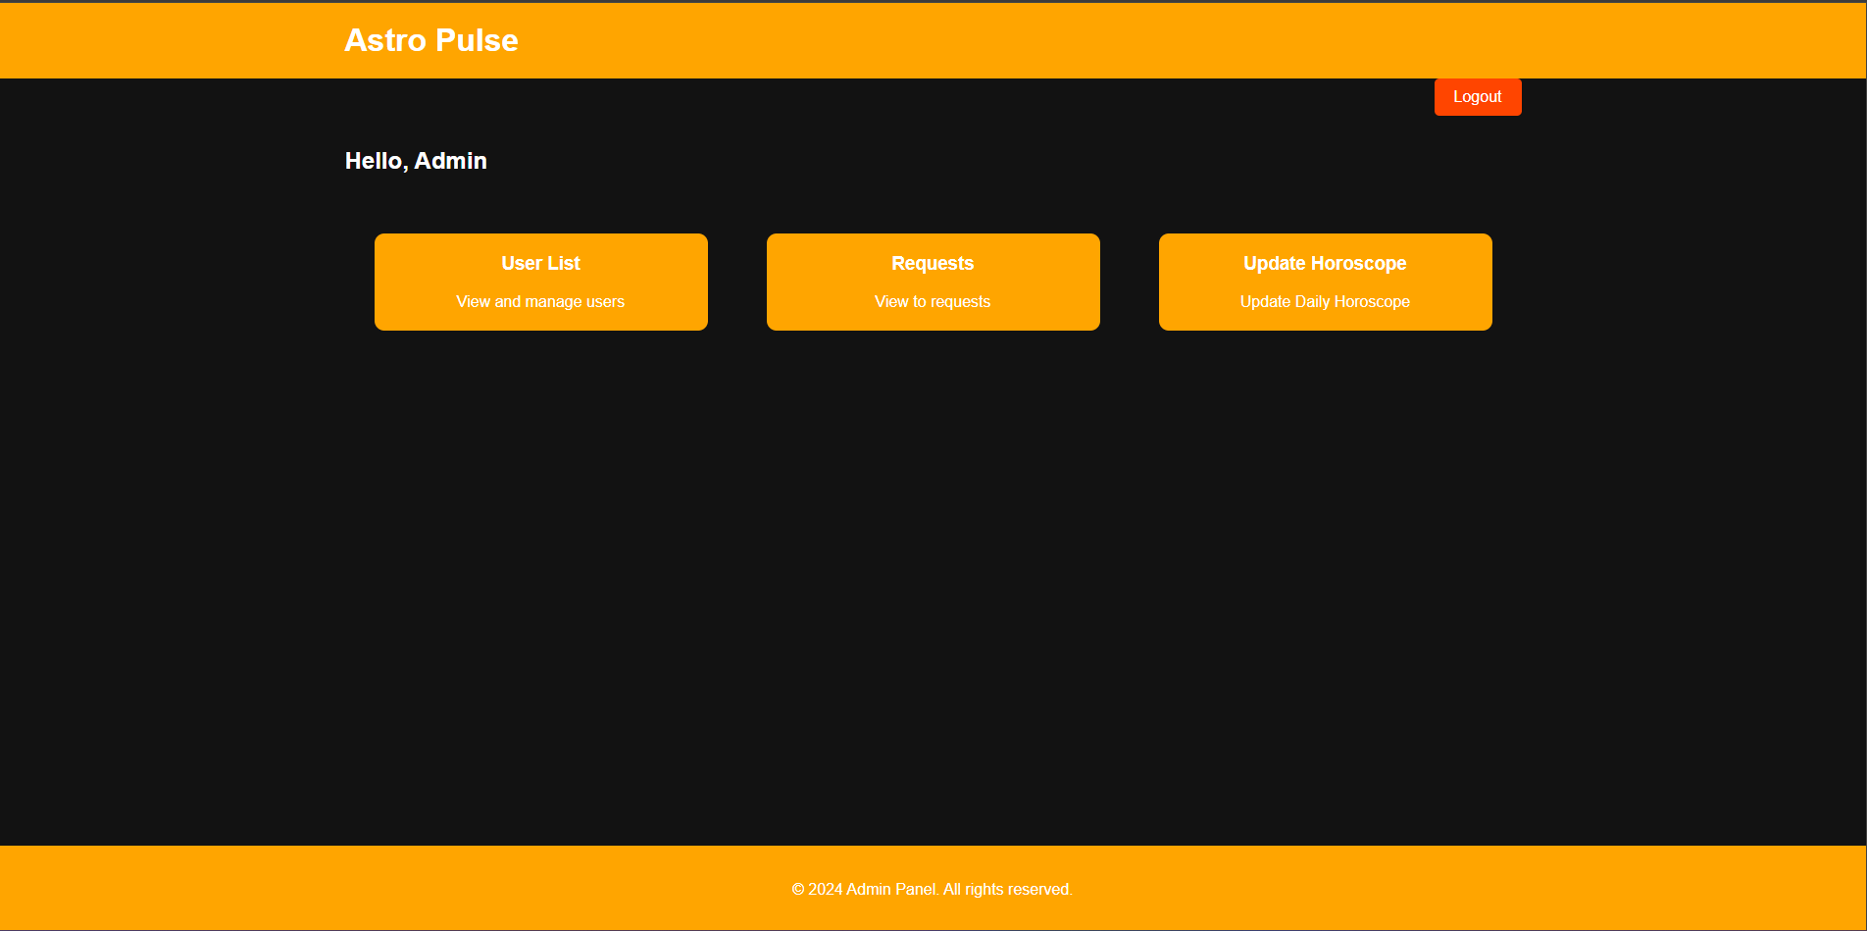

Slide 13
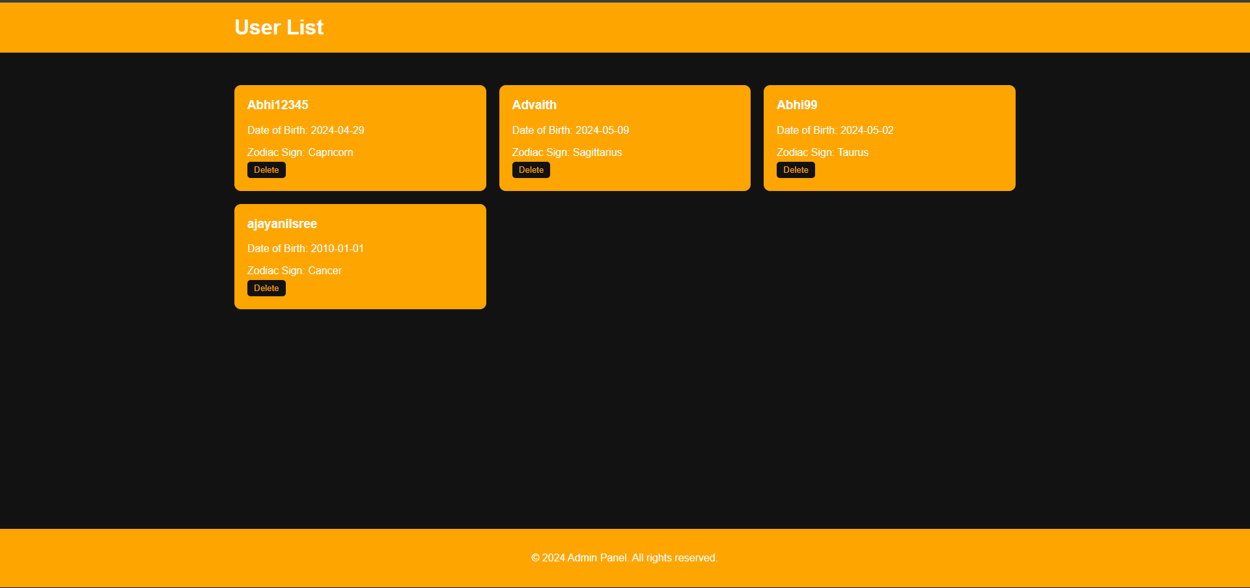

Slide 14
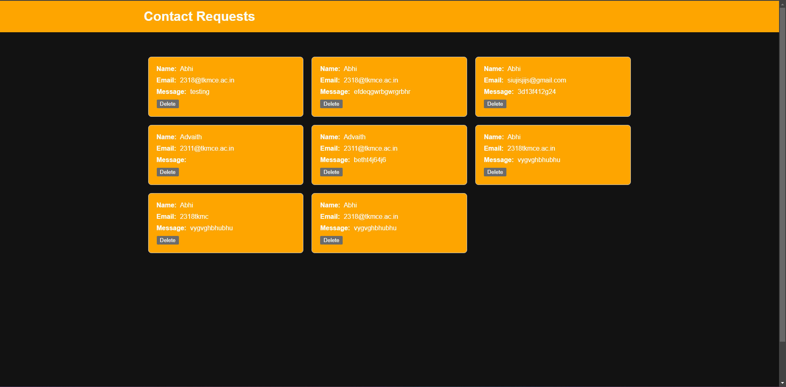

Slide 15
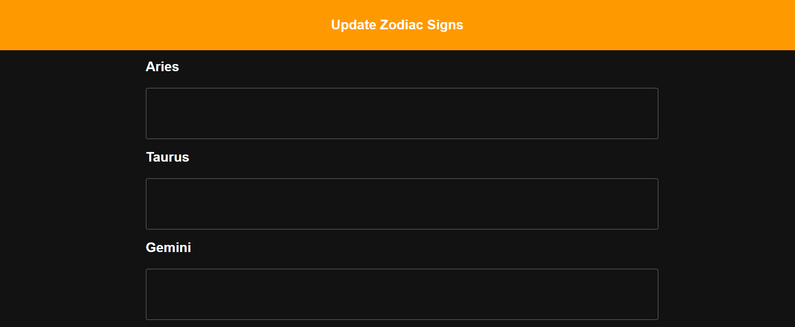

Slide 16
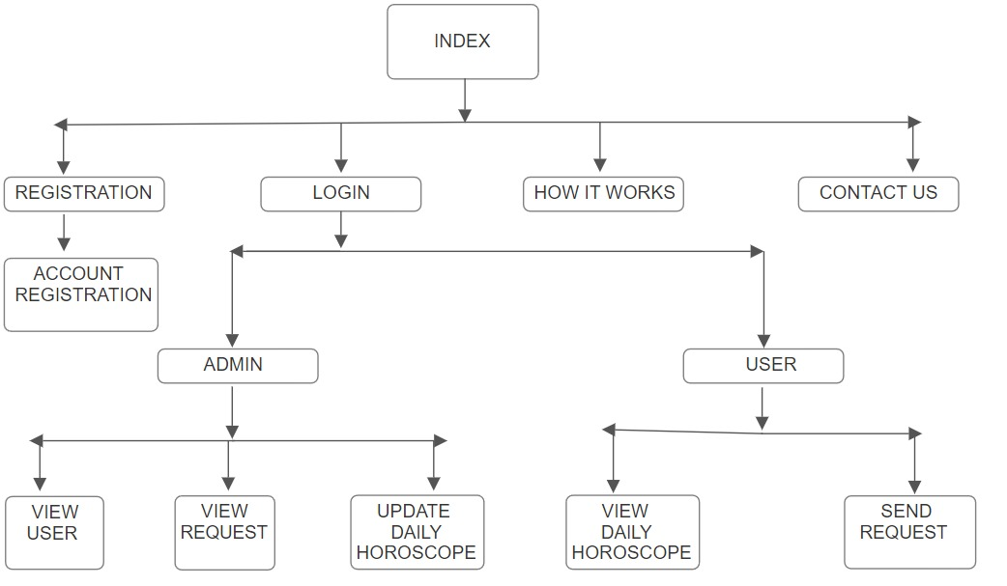

Slide 17
Thank You.

